Slide 1

Revolutionising B.Tech

Slide 2
Module 1: Fundamentals and basics in COA
Course Name: Computer Architecture and organization[22CSE104]
Total Hours : 12

Slide 3
Table of Content
Aim
Objectives
Functional Units
Basic Operational Concepts
Bus Structure
Performance
Multi Processors and Multi-computers
Encoders
Demultiplexers
Programmable Logic Arrays(PLAs)
Digital Logic Circuits
Basic Logic Functions
Synthesis of Logic Functions Using AND,OR and NOT Gates
Minimization of Logic Expressions

Slide 4
Table of Content
Synthesis with NAND and NOR Gates
Flip Flops
Self Assessments
Activities
Did You Know
Summary
Terminal Questions

Slide 5

Aim
To equip students in the fundamentals and understanding the Concepts of Interconnections of Computers and make them to design the Logic Gates.

Slide 6

Discuss on the various basic concepts and Structure of Computers.
Understanding different types of Logic Functions and Synthesis Techniques
Understanding and practice of Designing Encoders and Demutiplexer
Objective

Slide 7
Computer Organization
Computer organization refers to the operational units and their interconnections .
It deals with how the components of a computer system are arranged and how they interact to perform the required operations.
Computer organization is concerned with the physical implementation like Circuit Design, Peripherals and Adders.
Interconnection and communication between components, such as the bus structure, memory hierarchy, and input/output systems.
It is frequently called as Micro Architecture.

Slide 8
Computer Architecture
Computer Architecture delas with structure and behavior of Computer System.
Computer architecture refers to the design of the internal workings of a computer system, including the CPU, memory, and other hardware components.
It involves the logical functions such as Instruction sets, Data types, Registers and Addressing modes.
Computer architecture is concerned with optimizing the performance of a computer system and ensuring that it can execute instructions quickly and efficiently.
Computer Architecture is also called Instruction Set Architecture (ISA).

Slide 9
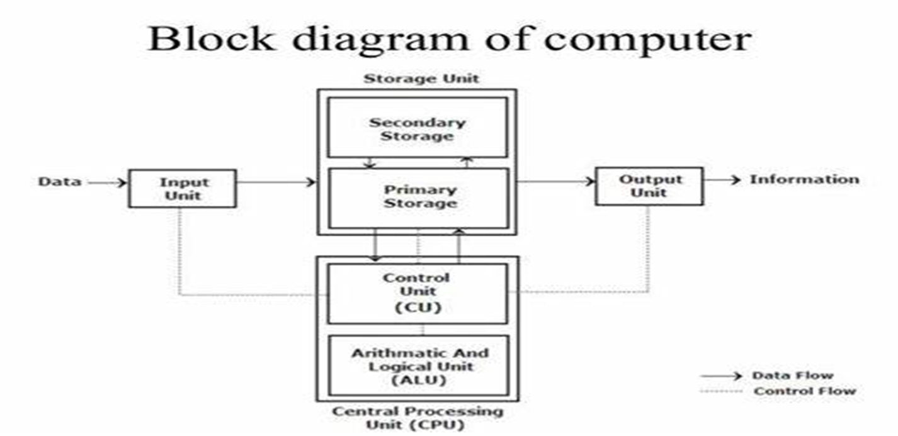
Functional Units of a Computer

Slide 10
Input Unit
Computers accept coded information through input units.
The most common input device is the keyboard.
When we give the input the corresponding letter or digit is automatically translated into its corresponding binary code and transmitted to the processor.
Human-computer interaction are available, including the touchpad, mouse, joystick, and trackball.
Graphic input devices in conjunction with displays.
Microphones can be used to capture audio input which is then sampled and converted into digital codes for storage and processing.
Cameras can be used to capture video input.
Digital communication facilities, such as the Internet, can also provide input to a computer from other computers and database servers.

Slide 11
Memory Unit
The function of the memory unit is to store programs and data.
There are two classes of storage, called primary and secondary.
Primary Memory Primary memory, also called main memory, is a fast memory that operates at electronic speeds.
The number of bits in each word is referred to as the word length of the computer, typically 16, 32, or 64 bits.
A memory in which any location can be accessed in a short and fixed amount of time after specifying its address is called a random-access memory (RAM).
The time required to access one word is called the memory access time. (MAT)
This time is independent of the location of the word being accessed. It typically ranges from a few nanoseconds (ns) to about 100 ns for current RAM units

Slide 12
Cache memory
Smaller, faster RAM unit, called a cache, is stored between CPU and main memory.
The cache is tightly coupled with the processor and is usually contained on the same integrated-circuit chip.
The purpose of the cache is to facilitate high instruction execution rates at faster Execution rates.
At the start of program execution, the cache is empty.
As execution proceeds, instructions are fetched into the processor chip, and a copy of each is placed in the cache.
When the execution of an instruction requires data, located in the main memory, the data are fetched and copies are also placed in the cache.

Slide 13
Secondary Storage
Secondary Storage are additional, less expensive is used to store large amounts of data .
Access times for secondary storage are longer than for primary memory.
The devices available are including magnetic disks, optical disks (DVD and CD), and flash memory devices.

Slide 14
Arithmetic and Logic Unit(ALU)
Computer operations are executed in the arithmetic and logic unit (ALU) of the processor.
Arithmetic operations Addition, Subtraction, Multiplication, Division.
Logical Operations AND,OR,NOT
When operands are brought into the processor, they are stored in high-speed storage elements called registers.
Each register can store one word of data.
Access times to registers are even shorter than access times to the cache unit on the processor chip.

Slide 15
Control Unit
The control unit controls and coordinate all the activities that sends control signals to other units.
Memory, arithmetic and logic, and I/O units store and process information and perform input and output operations.
Control units are responsible for generating the timing signals that govern the transfers.
Data transfers between the processor and the memory are also managed by the control unit through timing signals.
A large set of control lines carries the signals used for timing and synchronization of events in all units.

Slide 16
Output Unit
Output unit function is to send processed results to the outside world.
A familiar example of such a device is a printer.
laser printers, or ink jet streams. Such printers may generate output at speeds of 20 or more pages per minute.
Graphic displays provide both an output function showing text and graphics and an input function, through touchscreen capability.

Slide 17
Summarisation of Operations of a Computer
The operation of a computer can be summarized as follows:
• The computer accepts information in the form of programs and data through an input unit and stores it in the memory.
• Information stored in the memory is fetched and send to arithmetic and logic unit where it is processed.
• Processed information leaves the computer through an output unit.
• All activities in the computer are directed by the control unit.

Slide 18
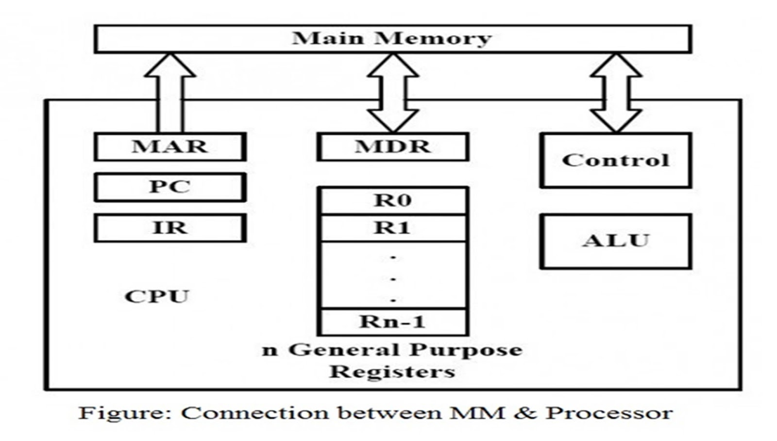
Basic operational Concepts

Slide 19
Registers
Register serves as a quick memory for accepting, storing, and sending data and instructions to the CPU .
A register is a collection of flip-flops, Single bit digital data is stored using flip-flops.
By combining many flip-flops, the storage capacity can be extended to accommodate a huge number of bits.

Slide 20
Operations performed in Registers
Fetch: The Fetch Operation is used to retrieve user-provided instructions that have been stored in the main memory. Registers are used to fetch these instructions.
Decode: The Decode Operation is used to interpret the Instructions, which means that the CPU will determine which Operation has to be carried out on the Instructions after the Instructions have been decoded.
Execute: The CPU manages the Execute Operation. The results that the CPU generates are then stored in the memory before being presented on the user screen.

Slide 21
Types of Registers
Types of Registers:
Status and control registers.
General-purpose data registers.
Special purpose register.

Slide 22
Status and control register
Status and control register report and allow the modification of the state of the processor and of the Program to be executed.
Instruction Format:
Address 0-11bits
Opcode 12-14 bits
I 14-15 bits
I | OPCODE | ADDRESS

Slide 23
General-Purpose Data Registers
General-Purpose Data Registers:
General purpose registers are extra registers that are present in the CPU and are utilized anytime data or a memory location is required.
They are used to store the data temporarily.
Operands for logical and arithmetic operations
Operands for address calculation
Memory pointers

Slide 24
Types of special purpose Register
Special Purpose Registers:
PC (program Counter) Keep track of the program Which are being Executed.
It contains the address of the Next Instruction to be fetched and Executed.
IR (Instruction Register)contains of the Instructions which is currently being Executed.
MAR(Memory Address Register)Address of the Location from the Memory.
MDR(Memory Data Register)Data which is read from the main memory.

Slide 25
BUS Structure
The bus is a communication channel.
The characteristic of the bus is shared transmission media.
The limitation of a bus is only one transmission at a time.
A bus used to communicate between the major components of a computer is called a System bus.

Slide 26
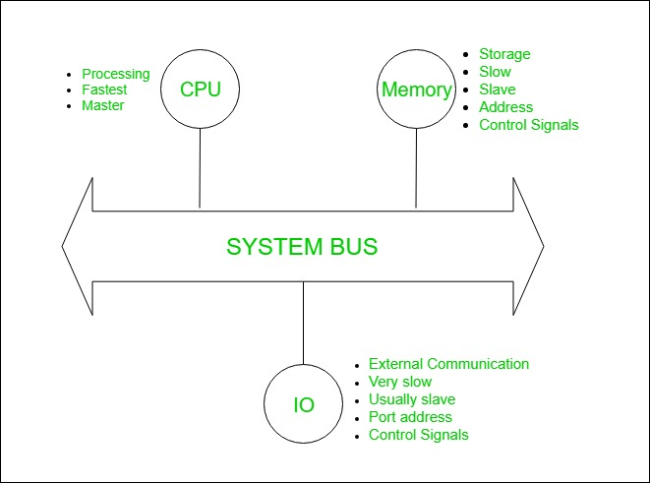
Block Diagram of Bus Structure

Slide 27
Categories of Bus Structure
System bus contains 3 categories of lines used to provide the communication between the CPU, memory and IO named as:
1. Address lines (AL) 2. Data lines (DL) 3. Control lines (CL)
1. Address Lines:
Used to carry the address to memory and IO.
Unidirectional.
Based on the width of an address bus we can determine the capacity of a main memory

Slide 28
Data Lines
2. Data Lines:
Used to carry the binary data between the CPU, memory and IO.
Bidirectional.
Based on the width of a data bus we can determine the word length of a CPU.
Based on the word length we can determine the performance of a CPU.

Slide 29
Control Lines
3. Control Lines:
Used to carry the control signals and timing signals
Control signals indicate the type of operation.
Timing Signals are used to synchronize the memory and IO operations with a CPU clock.
Typical Control Lines may include Memory Read/Write, IO Read/Write, Bus Request/Grant, etc.

Slide 30
Performance
Performance refers to the speed and efficiency at which a computer system can execute tasks and process data.
Processor speed: The speed of the processor, measured in GHz (gigahertz), determines how quickly the computer can execute instructions and process data.
Memory: The amount and speed of the memory, including RAM (random access memory) and cache memory, can impact how quickly data can be accessed and processed by the computer.
Storage: The speed and capacity of the storage devices, including hard drives and solid-state drives (SSDs), can impact the speed at which data can be stored and retrieved.
I/O devices: The speed and efficiency of input/output devices, such as keyboards, mice, and displays, can impact the overall performance of the system.
Software optimization: The efficiency of the software running on the system, including operating systems and applications, can impact how quickly tasks can be completed.

Slide 31
Factor for improving Performance
Reducing Time Complexity.
Upgrading Hardware Components
Optimizing Software
Addressing Bottlenecks in the system.

Slide 32
Multi Processor
1. Multiprocessor: A Multiprocessor is a computer system with two or more central processing units (CPUs) share full access to a common RAM.
The main objective of using a multiprocessor is to boost the system’s execution speed, with other objectives being fault tolerance and application matching.
There are two types of multiprocessors, one is called shared memory multiprocessor and another is distributed memory multiprocessor.
In shared memory multiprocessors, all the CPUs shares the common memory but in a distributed memory multiprocessor, every CPU has its own private memory.

Slide 33
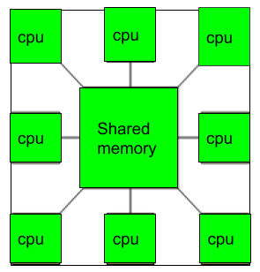
Multi Processor

Slide 34
Applications of Multi Processor
As a uniprocessor, such as single instruction, single data stream (SISD).
As a multiprocessor, such as single instruction, multiple data stream (SIMD), which is usually used for vector processing.
Multiple series of instructions in a single perspective, such as multiple instruction, single data stream (MISD), which is used for describing hyper-threading or pipelined processors.
Inside a single system for executing multiple, individual series of instructions in multiple perspectives, such as multiple instruction, multiple data stream (MIMD).

Slide 35
Multi Computer
A multicomputer system is a computer system with multiple processors that are connected together to solve a problem.
Each processor has its own memory and it is accessible by that particular processor and those processors can communicate with each other via an interconnection network.
As the multicomputer is capable of messages passing between the processors, it is possible to divide the task between the processors to complete the task.
Hence, a multicomputer can be used for distributed computing.
It is cost effective and easier to build a multicomputer than a multiprocessor.

Slide 36
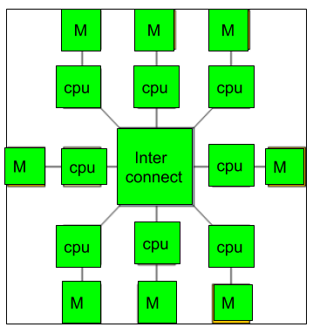
Multicomputer
Multicomputer

Slide 37
Encoder
An encoder is a digital circuit that converts a set of binary inputs into a unique binary code.
The binary code represents the position of the input and is used to identify the specific input that is active.
Encoders are commonly used in digital systems to convert a parallel set of inputs into a serial code.
An Encoder is a combinational circuit that performs the reverse operation of Decoder.
It has maximum of 2^n input lines and ‘n’ output lines, hence it encodes the information from 2^n inputs into an n-bit code. It will produce a binary code equivalent to the input, which is active High.
Therefore, the encoder encodes 2^n input lines with ‘n’ bits.

Slide 38
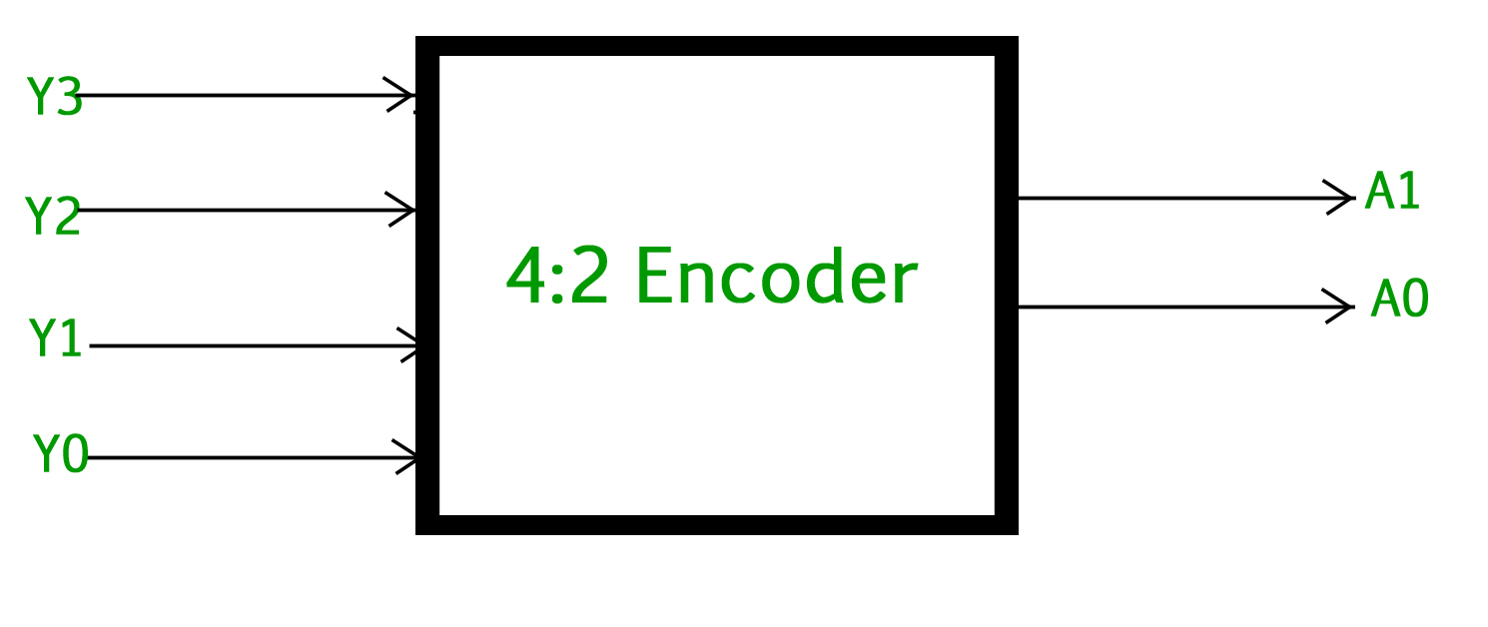
4:2 Encoder
4 : 2 Encoder
The 4 to 2 Encoder consists of four inputs Y3, Y2, Y1 & Y0 and two outputs A1 & A0. At any time, only one of these 4 inputs can be ‘1’ in order to get the respective binary code at the output. The figure below shows the logic symbol of 4 to 2 encoder :

Slide 39
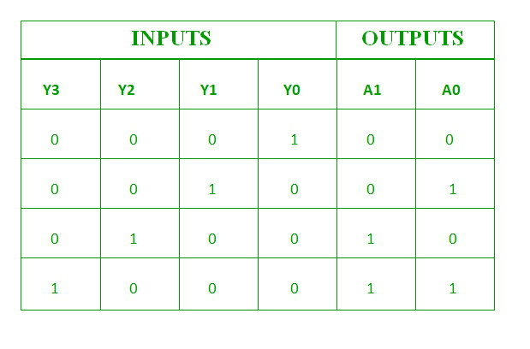
Truth Table
4:2 Encoder

Slide 40
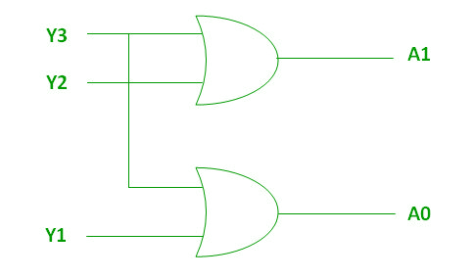
Implementation
Logical Expression for A0 and A1
A1=Y3+Y2
A0=Y3+Y1

Slide 41
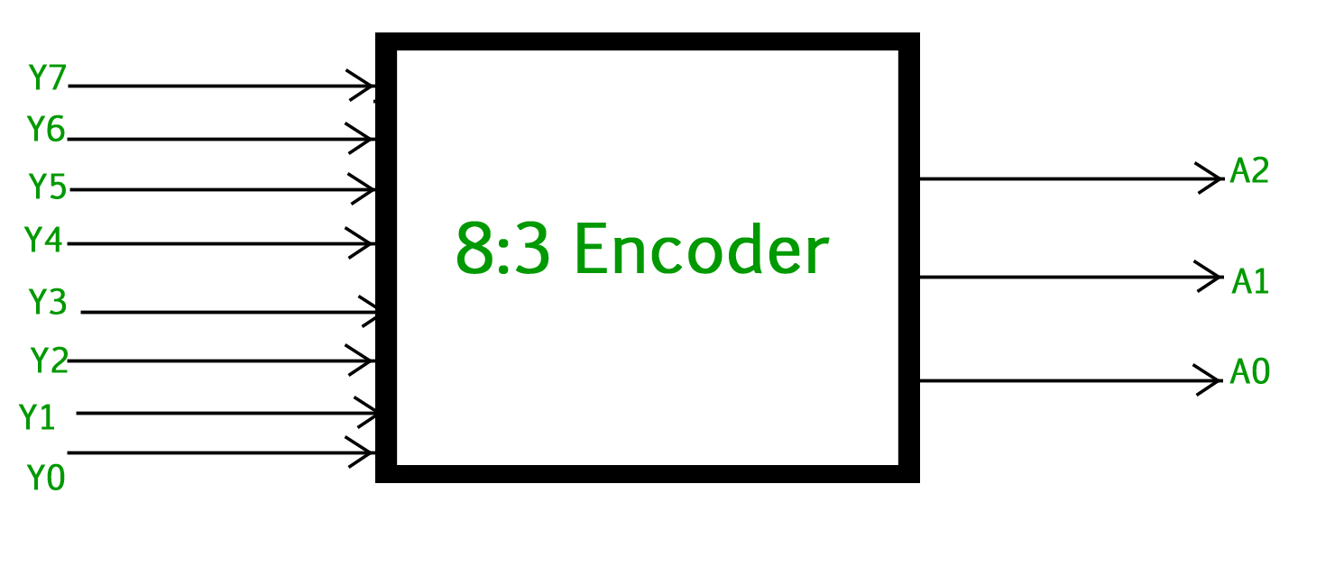
8 : 3 Encoder (Octal to Binary)
8 : 3 Encoder (Octal to Binary)
The 8 to 3 Encoder or octal to Binary encoder consists of 8 inputs : Y7 to Y0 and 3 outputs : A2, A1 & A0. Each input line corresponds to each octal digit and three outputs generate corresponding binary code. The figure below shows the logic symbol of octal to binary encoder:

Slide 42
TRUTH TABLE
D7 D6 D5 D4 D3 D2 D1 D0 X Y Z
0 0 0 0 0 0 0 1 0 0 0
0 0 0 0 0 0 1 0 0 0 1
0 0 0 0 0 1 0 0 0 1 0
0 0 0 0 1 0 0 0 0 1 1
0 0 0 1 0 0 0 0 1 0 0
0 0 1 0 0 0 0 0 1 0 1
0 1 0 0 0 0 0 0 1 1 0
1 0 0 0 0 0 0 0 1 1 1

Slide 43
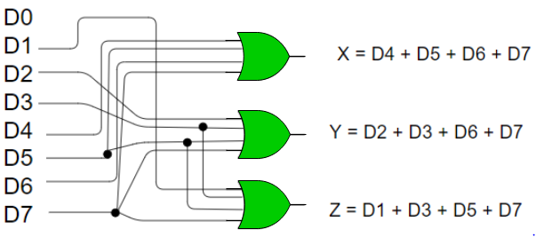
Implementation

Slide 44
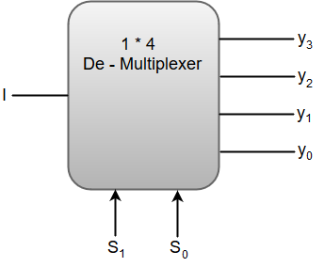
De-Multiplexers
De-Multiplexers
A De-multiplexer (De-Mux) can be described as a combinational circuit that performs the reverse operation of a Multiplexer.
A De-multiplexer has a single input, 'n' selection lines and a maximum of 2^n outputs.
The following image shows the block diagram of a 1 * 4 De-multiplexer.

Slide 45
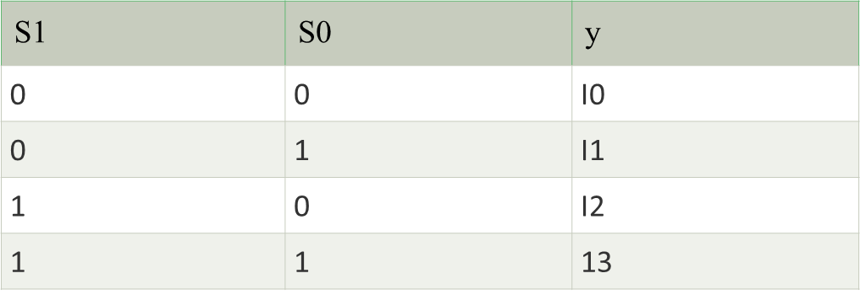
Function Table 4*1

Slide 46
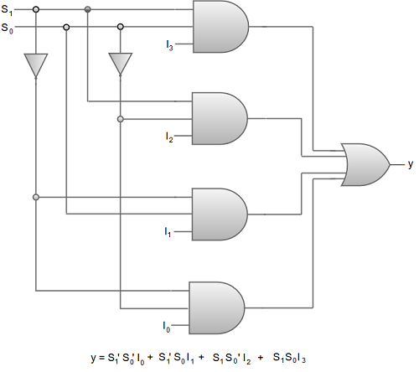
Implementation of 3AND and 1 OR

Slide 47
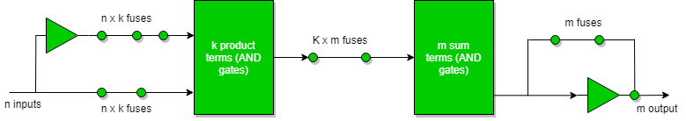
Programmable Logic Array(PLA)
Programmable Logic Array(PLA) is a fixed architecture logic device with programmable AND gates followed by programmable OR gates.
Basic block diagram for PLA:

Slide 48
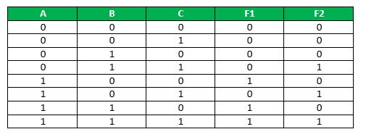
Truth Table
F1 = AB’C’ + ABC’ + ABC on simplifying we get : F1 = AB + AC’
F2 = A’BC + AB’C + ABC on simplifying we get: F2 = BC + AC

Slide 49
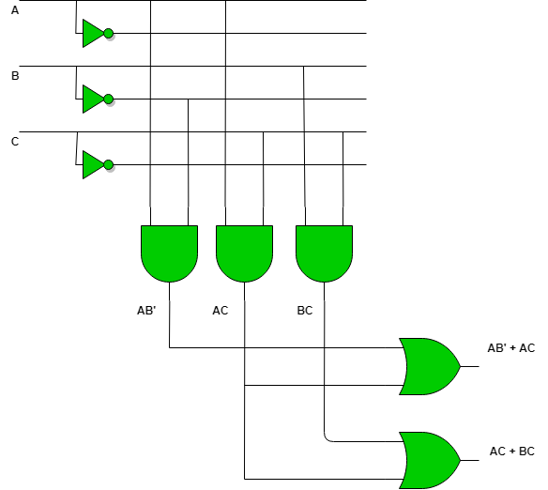
Circuit Diagram

Slide 50
Digital Logic Circuits
Digital logic circuits are the basis of digital systems. These logic circuits are a set of logic gates that show logical equivalence between two different groups of binary numbers.
These digital logic circuits use 0 and 1 for on/off conditions, where 0 represents on, and 1 represents off conditions.
Digital Logic Circuits are digital devices that use logic gates, ALU’s, microprocessors, RAM, ROM to control other circuits. It is a specific form of logic circuit that processes the numerical values 0 and 1.

Slide 51
Logic Circuits
Digital circuits are also called logical circuits because they perform logical operations on digital signals. Digital circuits use logic gates like AND, OR, NOT, NAND, and NOR to perform the required digital operations.
A digital circuit is a circuit containing digital logic. Digital circuits are the most common physical implementation of Boolean algebra and binary arithmetic and are the basis of all modern computers.
It is because digital circuits are mainly used to process data that has only two values, such as true or false.
In other words, it can be said that a digital circuit’s primary function is to process the information that manages the binary system. Digital circuits are called logical circuits because they perform logical operations and produce results that can be interpreted as True or False.

Slide 52
Types of Digital Logic Circuits:
1. Synchronous Systems:
Synchronous systems include clocks, our circadian rhythms, and periodic phenomena such as tides and waves. In electronics, an asynchronous system is a system in which the temporal behaviour of diﬀerent elements is related to each other. The timing of events in Synchronous systems depends on the signals clock.
2. Asynchronous Systems:
Asynchronous systems send out messages and perform operations in parallel without the need to wait for a response. This means that different processes can co-occur; that is, multiple functions can be running simultaneously.
3. Combinational Logic Circuits:
Combinational logic is a form of digital logic in which an input pattern is applied to a circuit, and the output pattern depends only on this input pattern. Logic gates are undoubtedly one of the most basic and essential building blocks of digital circuits.
4. Sequential Networks:
The sequence network is a type of balance equivalent network that is used for the balance power system. Invest and imagined working condition is set so that only one sequence component can be present in the voltage and current.

Slide 53
Basics of Logic Gates
Logic gates are used to carry out logical operations on single or multiple binary inputs and give one binary output. In simple terms, logic gates are the electronic circuits in a digital system.
Types of Basic Logic Gates
There are several basic logic gates used in performing operations in digital systems. The common ones are
OR Gate
AND Gate
NOT Gate
UNIVERSAL GATES
NAND GATE
Special GATES
EX-OR GATE
EX-NOR Gate

Slide 54
OR GATE
OR Gate
In an OR gate, the output of an OR gate attains state 1 if one or more inputs attain state 1.
The Boolean expression of the OR gate is Y = A + B, read as Y equals A ‘OR’ B.
The truth table of a two-input OR basic gate is given as
A | B | Y
0 | 0 | 0
0 | 1 | 1
1 | 0 | 1
1 | 1 | 1

Slide 55
AND GATE
AND Gate
In the AND gate, the output of an AND gate attains state 1 if and only if all the inputs are in state 1. The Boolean expression of AND gate is Y = A.B
The truth table of a two-input AND basic gate is given as
A | B | Y
0 | 0 | 0
0 | 1 | 0
1 | 0 | 0
1 | 1 | 1

Slide 56
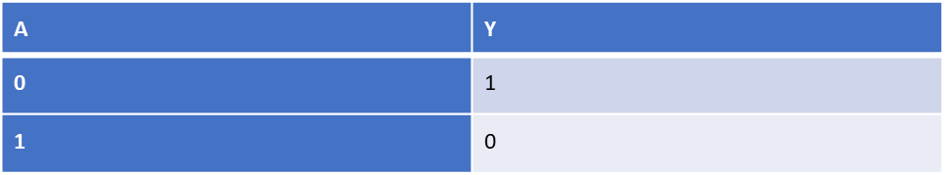
NOT GATE
NOT Gate
In a NOT gate, the output of a NOT gate attains state 1 if and only if the input does not attain state 1.
The Boolean expression is
Y=A(INVERSE)
It is read as Y equals NOT A.
The truth table of NOT gate is as follows

Slide 57
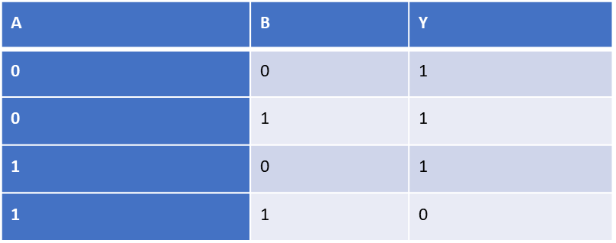
NAND GATE
NAND Gate
This basic logic gate is the combination of AND ,NOT gates.
The Boolean expression of the NAND gate is
Y=A.B(Inverse)
The truth table of a NAND gate is given as

Slide 58
NOR GATE
NOR Gate
This gate is the combination of OR and NOT gates.
The Boolean expression of the NOR gate is
Y=A+B(Inverse)
The truth table of a NOR gate is as follows
A | B | Y
0 | 0 | 1
0 | 1 | 0
1 | 0 | 0
1 | 1 | 0

Slide 59
Exclusive-OR gate (XOR Gate)
In an XOR gate, the output of a two-input XOR gate attains state 1 if one adds only input and attains state 1.
The Boolean Expression for XOR gate is
A.B+A.B or Y=A + B
A | B | Y
0 | 0 | 0
0 | 1 | 1
1 | 0 | 1
1 | 1 | 0

Slide 60
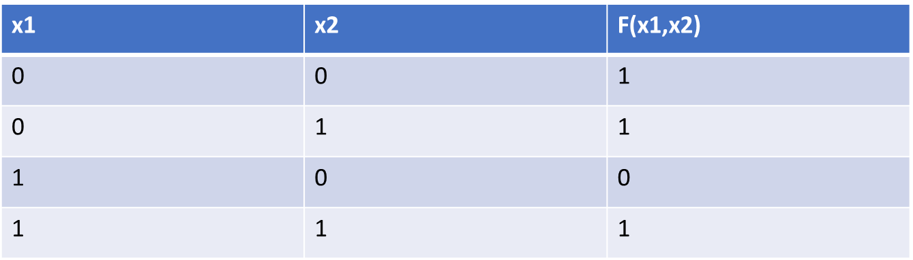
Synthesis of digital circuits
Synthesis is the process of generating a circuit that realizes a functional behavior of a logic system from a given description (stated in form of verbal statements, truth table, K-map, state diagram, etc.)
Example: Synthesize a logic function that realizes the following truth table. Use AND, OR, and NOT gates

Slide 61
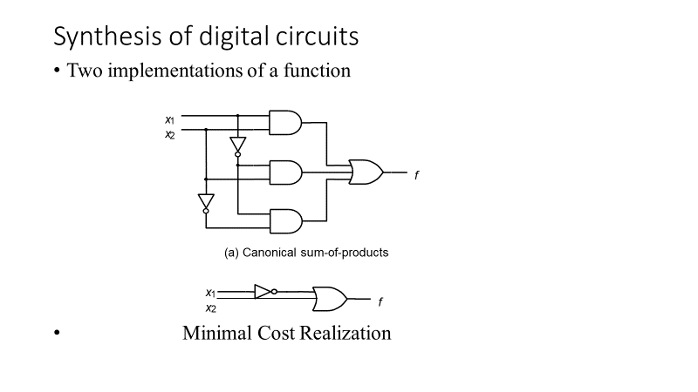
Synthesis of Digital Circuits
Two implementations of a function

Slide 62
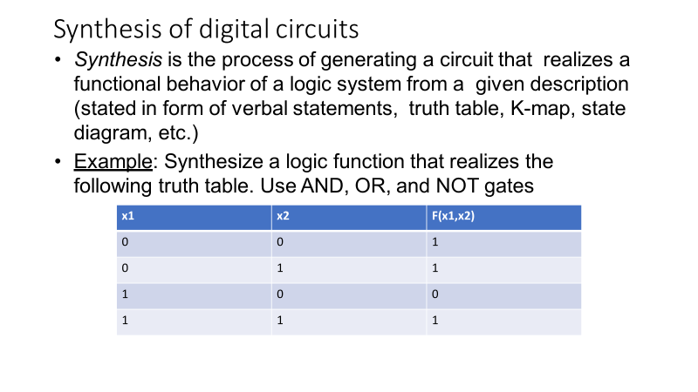
Synthesis of Digital Circuits

Slide 63
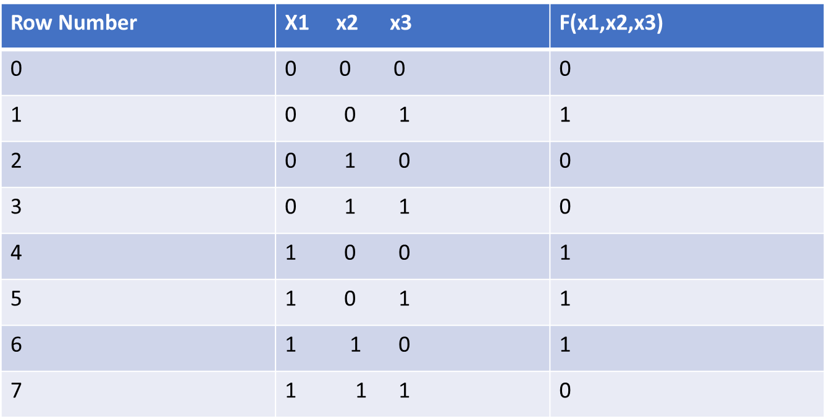
Synthesis of Digital Circuits

Slide 64
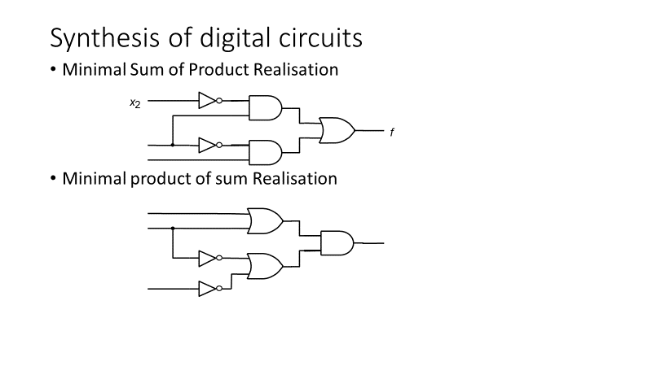
Synthesis of Digital Circuits

Slide 65
Minimization of Logic EXPRESSIONS
K-map can take two forms Sum of Product (SOP) and Product of Sum (POS) according to the need of problem. K-map is table like representation but it gives more information than TRUTH TABLE. We fill grid of K-map with 0’s and 1’s then solve it by making groups.
Steps to solve expression using K-map-
Select K-map according to the number of variables.
Identify minterms or maxterms as given in problem.
For SOP put 1’s in blocks of K-map respective to the minterms (0’s elsewhere).
For POS put 0’s in blocks of K-map respective to the maxterms(1’s elsewhere).
Make rectangular groups containing total terms in power of two like 2,4,8 ..(except 1) and try to cover as many elements as you can in one group.
From the groups made in step 5 find the product terms and sum them up for SOP form.

Slide 66
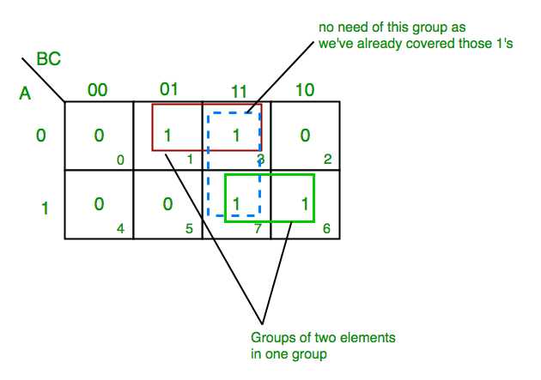
SOP Form K-Map for 3 variable
Z= ∑A,B,C(1,3,6,7)

Slide 67
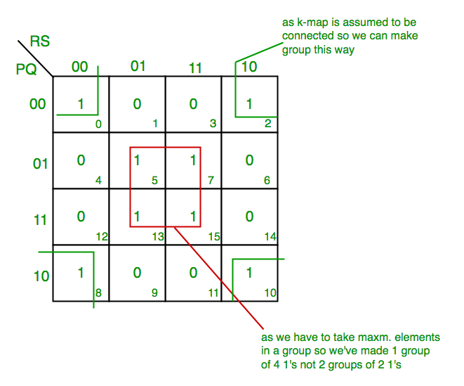
SOP Form K-Map for 4 Variable
F(P,Q,R,S)=∑(0,2,5,7,8,10,13,15)

Slide 68
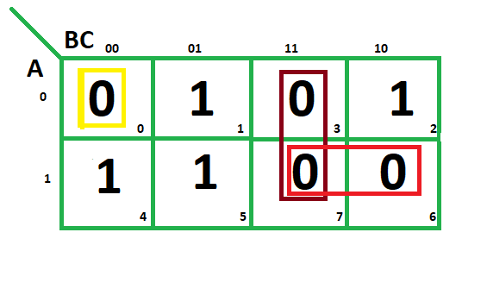
POS FORM K-Map for 3 variable
F(A,B,C)=π(0,3,6,7)

Slide 69
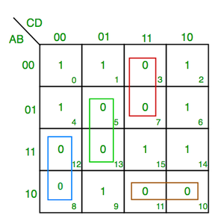
POS FORM K-Map for 4 variable
F(A,B,C,D)=π(3,5,7,8,10,11,12,13)

Slide 70
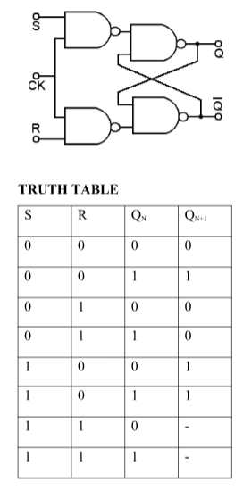
Flip Flop
Flip-flop is a circuit that maintains a state until directed by input to change the state. A basic flip-flop can be constructed using four-NAND or four-NOR gates. Types of flip-flops:
SR Flip Flop
JK Flip Flop
D Flip Flop
T Flip Flop
Logic diagrams and truth tables of the different types of flip-flops
are as follows:
S-R Flip Flop :
Characteristics Equation for SR Flip Flop: Q_{N+1} = Q_{N}R’ + SR’

Slide 71
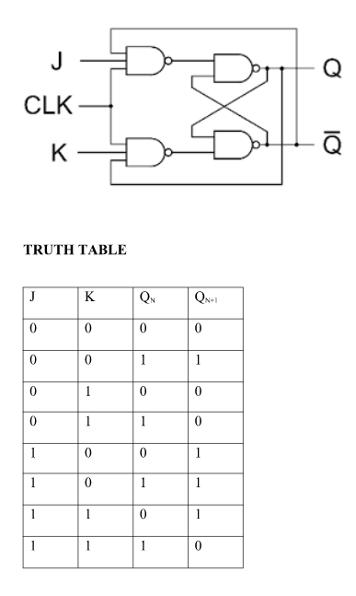
JK FLIP FLOP

Slide 72
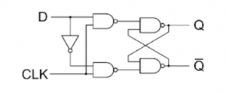
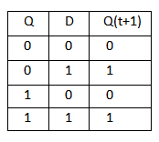
D-Flip Flop
Characteristics Equation for D Flip Flop: Q_{N+1} = D

Slide 73
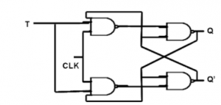
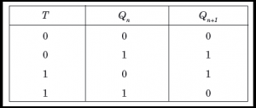
T FLIP FLOP

Slide 74
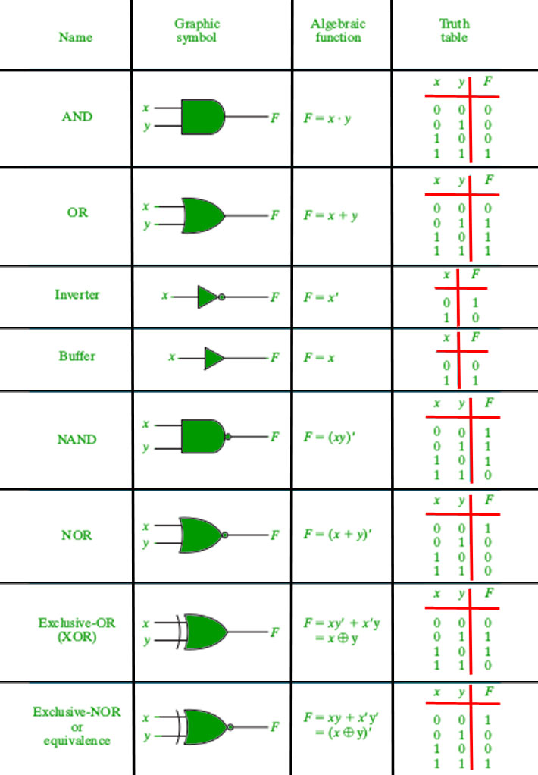
LOGIC GATES

Slide 75

Did You Know?
An encoder converts a set of binary inputs into a unique binary code.
Registers are fast Computer Memory

Slide 76

Summary
Outcomes:
Discuss the theory functionality and basic architecture of CPU
Discuss the Design Issues on the basis of speed, Technology, cost and performance.
Illustrate the different Logic Gates and Minimization of Logic gates.

Slide 77
Terminal Questions
What are the different types of Logic Gates?
What is Encoders?

Slide 78
Reference Links
https://www.geekforgeeks.org/computer organization
Reference Material:
William Stallings "Computer Organization and Architecture”,6Th Edition,Pearson/PHIISBN:10:0-13-609704-9

Slide 79
Thank you

